Slide 1
NORTHERN LIGHTS’ HUNTER application
GIEDRE KAVALIUNAITE
ANDREI ATUDOREI
ANDREI TRANDAFIR
BERTEA RAZVAN
PATRICIA GASPAR
VIVIEN DECKER

Slide 2
Company name: Northern Enough
Digital service concept: Northern Lights Hunter
Innovative and unique app providing necessary conditions about:
weather,
KP index,
solar activity, all in accordance to location and travel date,
a “to plan” function - the user can book flights, accommodation and check for places to visit.

Slide 3
Company name: Northern Enough
Digital service concept: Northern Lights Hunter
Our app is designed specifically for travelers from all over the world who want to explore the natural phenomenon of Aurora Borealis, even if they are experienced hunters or planning to travel for the first time. The users have the chance to share their experiences, photos, stories or even inspire each other within our community.

Slide 4
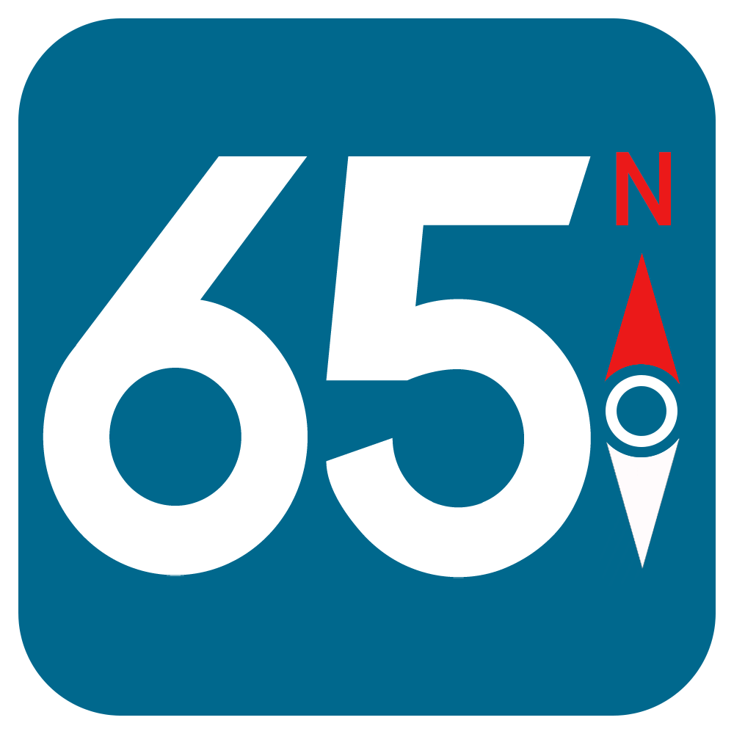
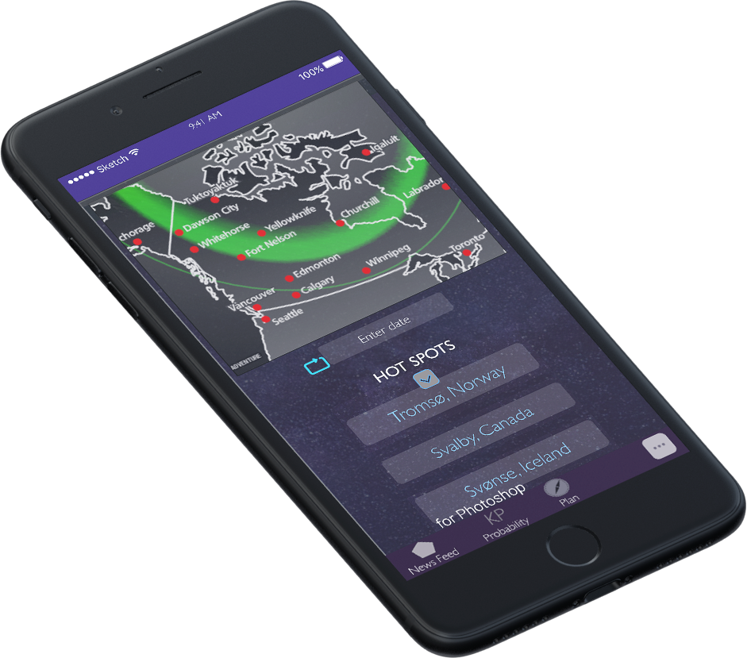
Visual Identity:
Logo: 65 degrees Northern Latitude, the starting point of the subpolar climat, the only climat with the visibility of the Northern Lights, followed by a compass, representing the guidance during the journey.
Colours: specific to the places with this natural phenomenon,
both the website and the app are made using dark cold colours. Another important choice for those dark colours where for the app, because the eye-sight of the travelers will be adjusted to the night’s darkness, and therefore we do not want them to have a fully bright app in front of their eyes, which could alterate their night vision and therefore affect their experience.

Slide 5
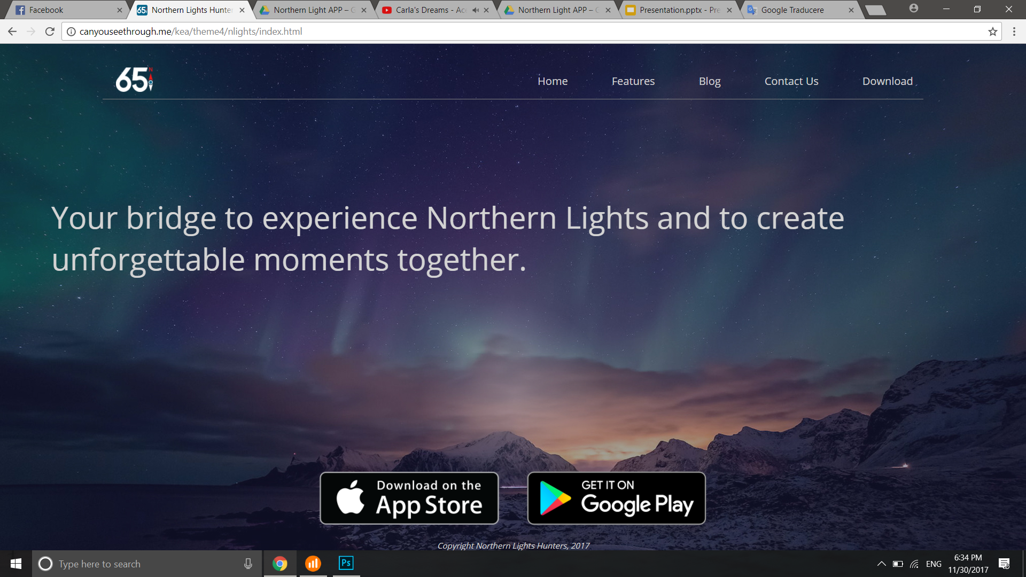
The users will easily find what about our app is about, from the App Store or Google Play. Also, by visiting our website they can see the features and the blog, getting a right image about our product.
Made in a simple and modern way, the responsive website is easy to read and to use.
The users can access the features page to get a better view about the app, or take a look on the blog to learn about the Northern Light’s hunter’s community.

Slide 6
Take a look at the website
http://canyouseethrough.me/kea/theme4/nlights/index.html

Slide 7
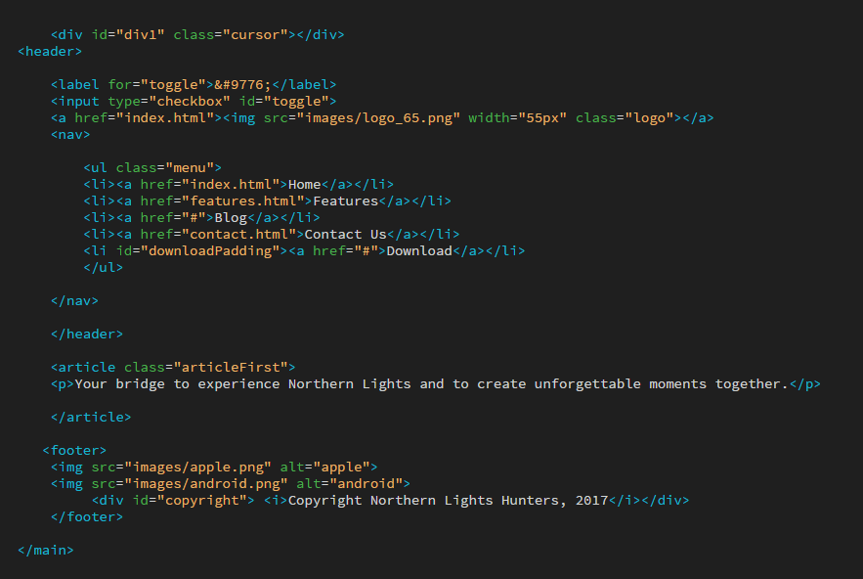
Let’s talk a little bit about what is behind the code.
You don’t need a lot of knowledge to create your company website.
You need just an innovative idea

Slide 8
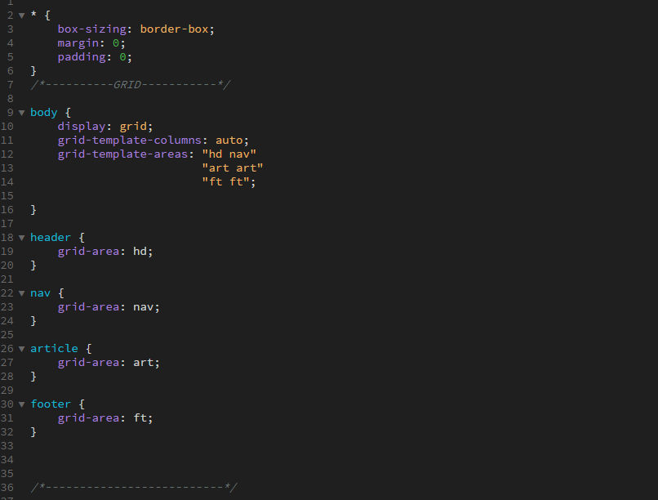
The whole website is built on grid in order to be responsive and to make the job easier for everyone.

Slide 9
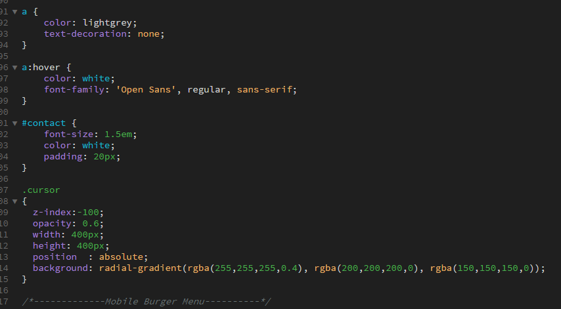
In the end I realised that I didn’t use any Js and I tried to make something different. This is the CSS for the glowing cursor.

Slide 10
Digital Services

Slide 11
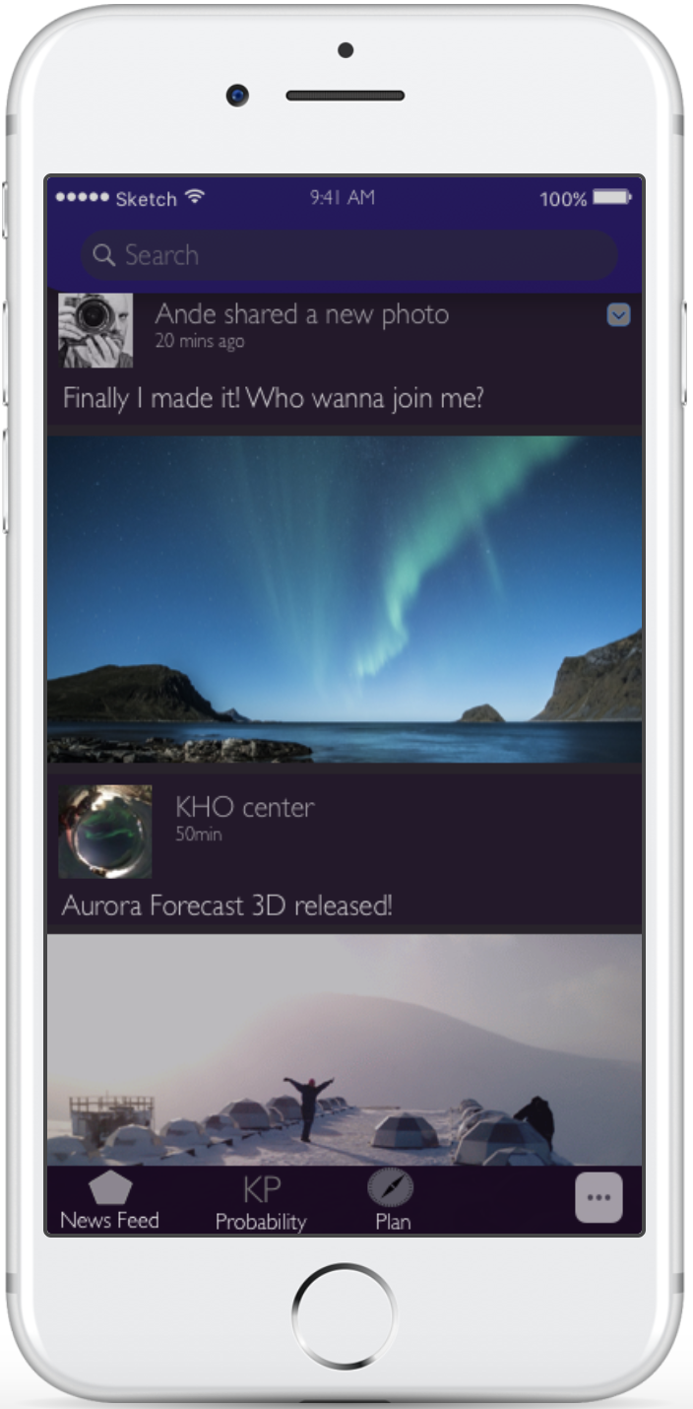
1.Community
get the most relevant updates and news
share your own experiences
join meetups
experience Northern Lights through live streams or
share your awesome photographer’s skills!
connect with like-minded people

Slide 12
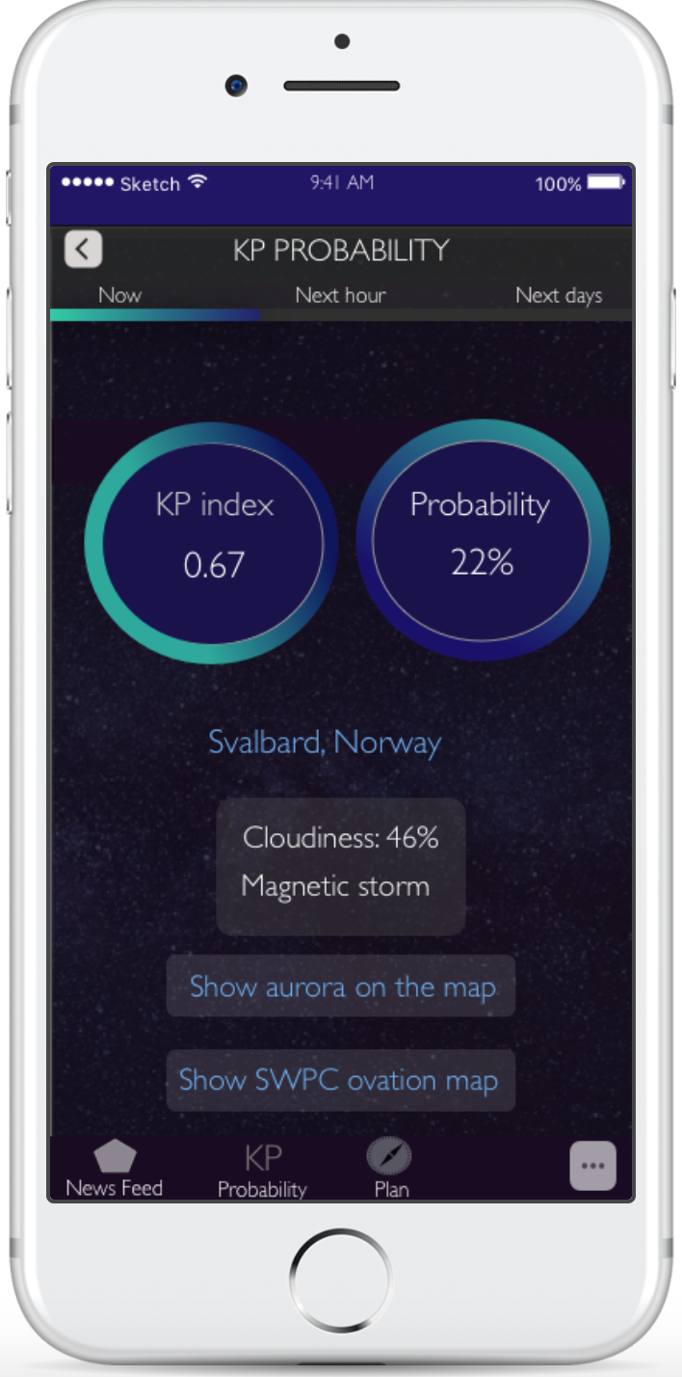
2.Forecasts
KP index, cloudiness, magnetic field, temperature- we got it all!
forecast is updated every minute and shows accurate information for the time being, next hour or next days
customized notifications will lead to experience the best and unforgettable moments

Slide 13
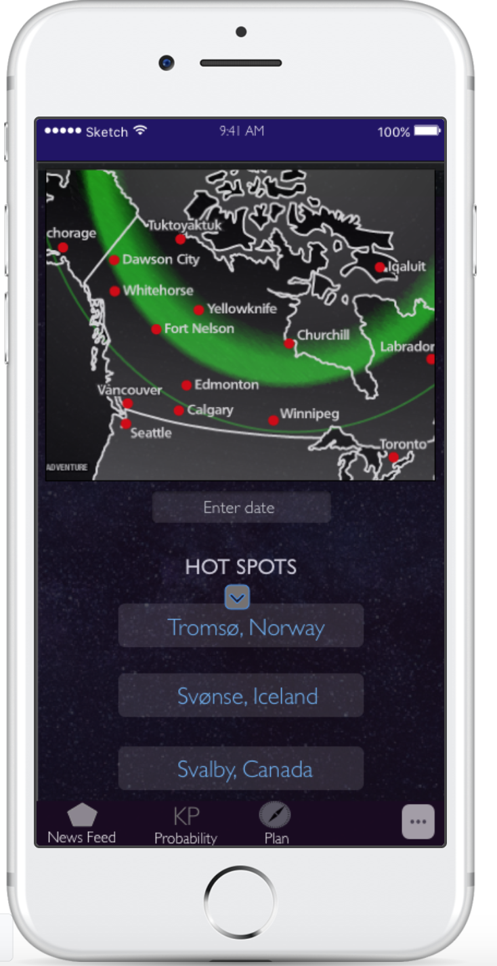
3.Plan
get inspired where to travel by exploring the map
if you don’t have any idea - the ist of hot spots is provided!

Slide 14
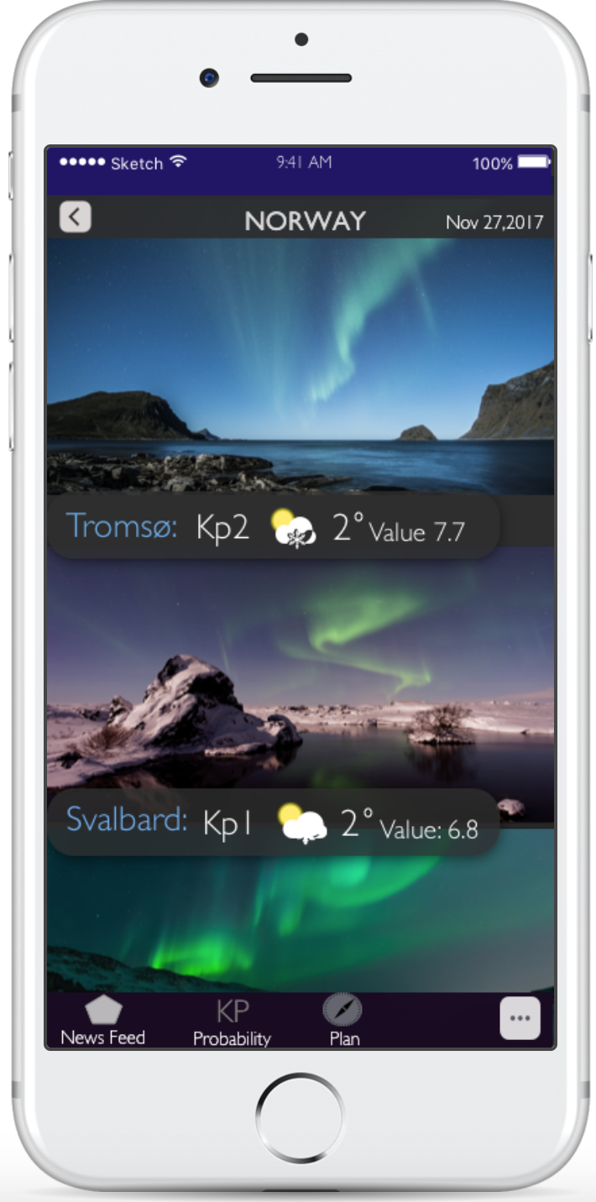
3.Plan (2)
hot spots are displayed by combining two important factors – overall rate based on other hunters’ experience and forecast for Northern Lights probability during selected travel dates.

Slide 15
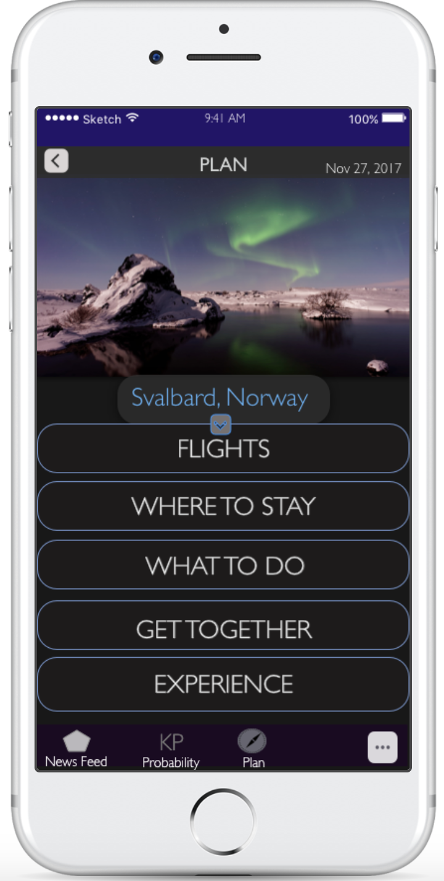
3.Plan (3)
when you know where you are headed to - we have your back as well! Explore the best options how to get to your desired location, deciding on the places where to stay or to eat!

Slide 16
Prototype
LIVES HERE: https://marvelapp.com/11fh3cig/screen/35337803

